Slide 1

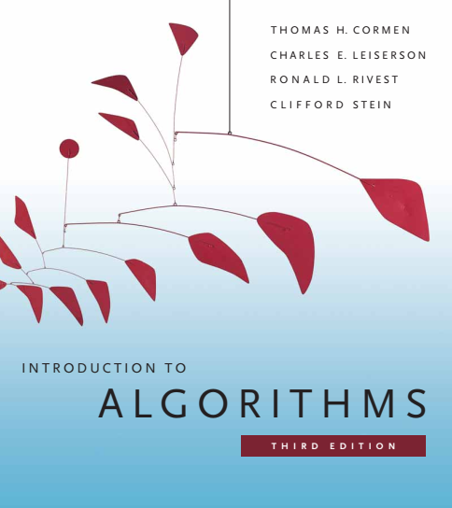
Design and Analysis of Algorithms
Dr. Sajid Iqbal
sajidiqbal.pk@gmail.com
Reference Book
Introduction to Algorithms 3rd Edition By Thomas H. Cormen et. al.
https://mitpress.mit.edu/books/introduction-algorithms-third-edition
COMEDXD

Slide 2
Basic Data Structures
Linked list

Slide 3
Introduction to Linked List
A data structure in which the data items are arranged in a linear order
Instead of having an index for each item, each item in a linked list contains a pointer that points to next element
Linked lists provide a simple, flexible representation for dynamic sets, that supports the following operations
SEARCH(S, k)
INSERT(S, x)
DELETE(S, x)
MINIMUM(S)
MAXIMUM(S)
SUCCESSOR(S, x)
PREDECESSOR(S, x)

Slide 4










Linked List
head
tail
Types of Linked List
Singly linked list
Double linked list
Circular linked list
Head: A particular node is designated as start point of linked list known as head node
Tail: A node which is designated as last node
A list may be sorted or unsorted
D | P
D | P
D | P
D | $$∅$$
$$∅$$ | D | $$P_{f}$$
$$P_{b}$$ | D | $$P_{f}$$
$$P_{b}$$ | D | $$P_{f}$$
$$P_{b}$$ | D | $$∅$$
D | P
D | P
D | P
D | $$P$$
$$P_{b}$$ | D | $$P_{f}$$
$$P_{b}$$ | D | $$P_{f}$$
$$P_{b}$$ | D | $$P_{f}$$
$$P_{b}$$ | D | $$P_{f}$$

Slide 5

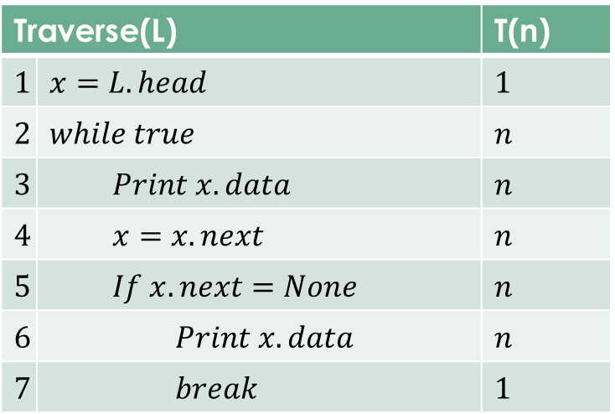
Traversing a Singly Linked List
Traversing: Reading a linked list is done by following the pointers
Traverse(L) |  | T(n)
$$1$$ | $$x=L.head$$ | $$1$$
$$2$$ | $$while true$$ | $$n$$
$$3$$ | $$Print x.data$$ | $$n$$
$$4$$ | $$x=x.next$$ | $$n$$
$$5$$ | $$If x.next=None$$ | $$n$$
$$6$$ | $$Print x.data$$ | $$n$$
$$7$$ | $$break$$ | $$1$$
head
D | P
D | P
D | P
D | $$∅$$
x
$$T\left(n\right)=5n+2=θ(n)$$

Slide 6
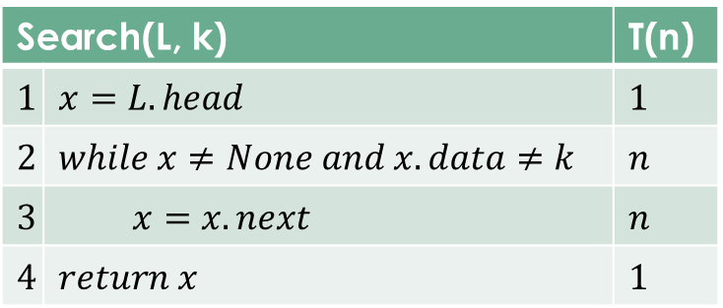


Searching in a singly linked list
Search(L, k) |  | T(n)
$$1$$ | $$x=L.head$$ | $$1$$
$$2$$ | $$while x≠None and x.data≠k$$ | $$n$$
$$3$$ | $$x=x.next$$ | $$n$$
$$4$$ | $$return x$$ | $$1$$
head
D | P
D | P
D | P
D | $$∅$$
x
$T\left(n\right)≤1+n+n+1$
$T\left(n\right)≤2n+2$
$T\left(n\right)=O(n)$
Best case: $O(1)$
Average Case: $O(n)$
Worst Case: $θ(n)$

Slide 7

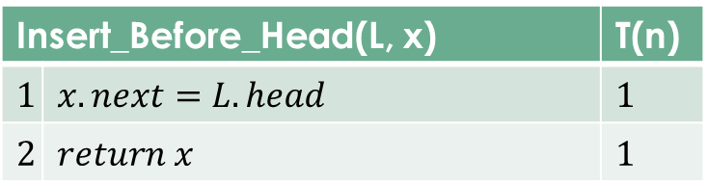
Inserting into Singly Linked List
Inserting into a list can have following cases
Insert in front of head
Insert at the end after tail
Insert within the list
Let x is node to be inserted in front of head
head
D | P
D | P
D | P
D | $$∅$$
Insert_Before_Head(L, x) |  | T(n)
$$1$$ | $$x.next=L.head$$ | $$1$$
$$2$$ | $$return x$$ | $$1$$
x
$T\left(n\right)=O\left(1\right)$
Hence this operations takes unit time

Slide 8
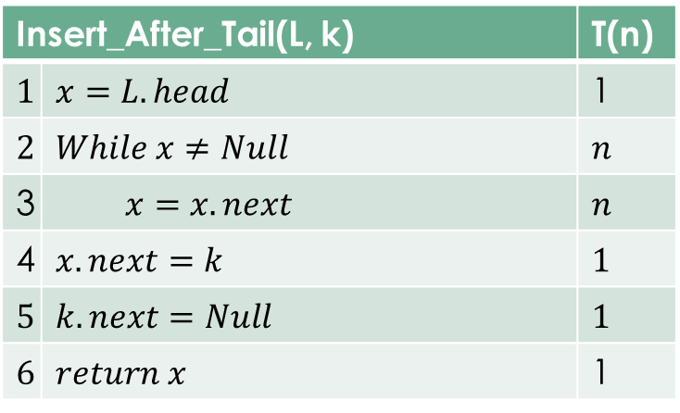

Inserting after tail in Linked List
Let x is node to be inserted in front of head
Insert_After_Tail(L, k) |  | T(n)
$$1$$ | $$x=L.head$$ | 1
$$2$$ | $$While x≠Null$$ | $$n$$
3 | $$x=x.next$$ | $$n$$
4 | $$x.next=k$$ | $$1$$
$$5$$ | $$k.next=Null$$ | $$1$$
$$6$$ | $$return x$$ | 1
head
D | P
D | P
D | P
D | $$∅$$
x
$$T\left(n\right)=θ\left(n\right)$$

Slide 9
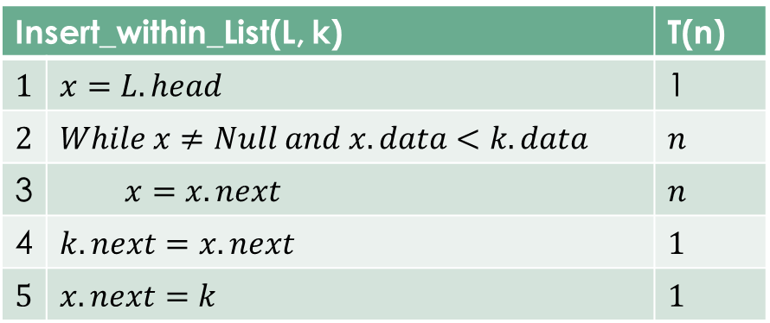

Inserting within linked list
Inserting an element with in linked list can be either on the basis of index or data value.
Here we list inserting based on data value
head
x
Insert_within_List(L, k) |  | T(n)
$$1$$ | $$x=L.head$$ | 1
$$2$$ | $$While x≠Null and x.data<k.data$$ | $$n$$
3 | $$x=x.next$$ | $$n$$
4 | $$k.next=x.next$$ | $$1$$
$$5$$ | $$x.next=k$$ | $$1$$
D | P
D | P
D | P
D | $$∅$$
D | P
k
Best Case $T\left(n\right)=θ\left(1\right)$
Average Case $T\left(n\right)=O\left(n\right)$
Worse Case $T\left(n\right)=θ\left(n\right)$

Slide 10
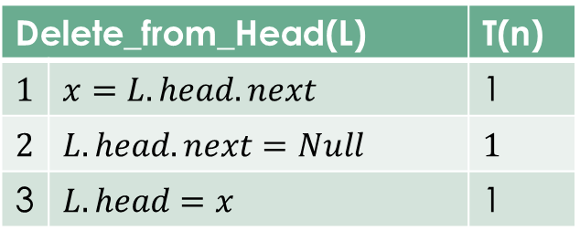

Deleting from Linked List
Like Insert, deleting could also have three cases
Delete the head
Delete the tail
Delete from within the list
Deleting the Head
head
x
D | P
D | P
D | P
D | $$∅$$
Delete_from_Head(L) |  | T(n)
$$1$$ | $$x=L.head.next$$ | 1
$$2$$ | $$L.head.next=Null$$ | $$1$$
3 | $$L.head=x$$ | 1
$$T\left(n\right)=θ\left(1\right)$$

Slide 11
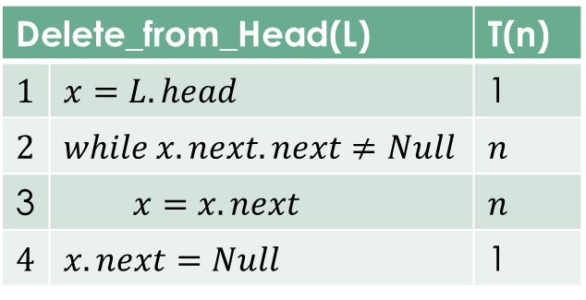

Deleting from End of Linked List
Deleting the Tail
Delete_from_Head(L) |  | T(n)
$$1$$ | $$x=L.head$$ | 1
$$2$$ | $$while x.next.next≠Null$$ | $$n$$
3 | $$x=x.next$$ | $$n$$
$$4$$ | $$x.next=Null$$ | 1
head
x
D | P
D | P
D | P
D | $$∅$$
$$T\left(n\right)=θ\left(n\right)$$

Slide 12
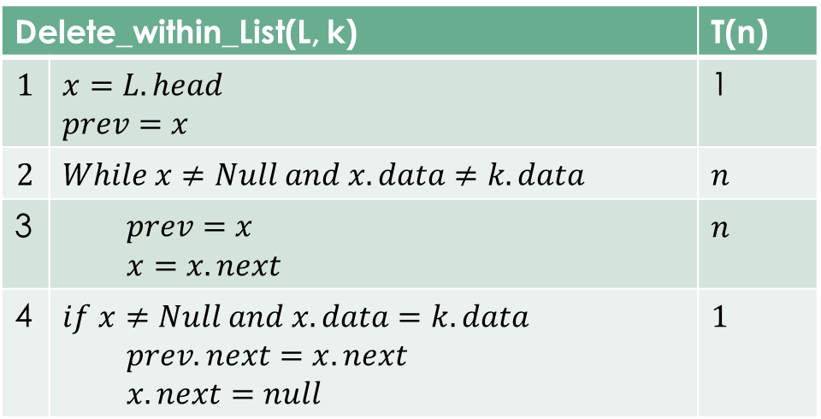

Deleting within linked list
Deleting an element with in linked list can be either on the basis of index or data value.
Here we list deletion based on data value
head
x
Delete_within_List(L, k) |  | T(n)
$$1$$ | $$x=L.head$$ $$prev=x$$ | 1
$$2$$ | $$While x≠Null and x.data≠k.data$$ | $$n$$
3 | $$prev=x$$ $$x=x.next$$ | $$n$$
4 | $$if x≠Null and x.data=k.data$$ $$prev.next=x.next$$ $$x.next=null$$ | $$1$$
D | P
D | P
D | P
D | $$∅$$
k
Best Case $T\left(n\right)=θ\left(1\right)$
Average Case $T\left(n\right)=O\left(n\right)$
Worse Case $T\left(n\right)=θ\left(n\right)$

Slide 13
List Search
The procedure is very similar to List_Delete method given in previous slide. Try to design this method yourself.

Slide 14
Linked List in Python
class Node: def __init__(self, dataval=None): self.dataval = dataval self.nextval = None class SLinkedList: def __init__(self): self.headval = None list1 = SLinkedList() list1.headval = Node("First Node") e2 = Node("Second node") list1.headval.nextval = e2 # Link first Node to second node e3 = Node("Third Node") e2.nextval = e3 # Link second Node to third node e3.nextval=None

Slide 15

Thanks for watching
Dr. Sajid Iqbal
Assistant Professor
Department of Computer Science
Bahauddin Zakariya University, Multan
sajidiqbal.pk@gmail.com
Slides: https://github.com/sajjo79/Design_and_Analysis_of_Algorithms
YouTube Channel: COMEDXD
Allah Hafiz

